Slide 1
Estimating the Unseen

Slide 2
Introduction
What can one infer about an unknown distribution based on a random sample?
If the sample size is sufficiently large like having 1000 independent draws from a distribution with 100 distinct elements, even empirical estimation can yield a more accurate distribution.
But what if we are presented with a smaller sample like having 100 independent draws from a distribution with 1000 distinct elements.
Empirical estimation will yield poor approximation of the true distribution in such cases.

Slide 3
Why do we need it?
This challenge of inferring properties of a distribution given a small sample of it occurs in various scenarios.
May real-world machine learning and data analysis tasks face this situation.
Estimating the vocabulary of a large corpus given a small sample of it.
In the study of genetic mutations across a population.
User data which represents only a small sample of the total number of users.
Many database management tasks employ sampling techniques to optimize query execution.
So, we need better estimators giving more accuracy even with smaller samples.

Slide 4
Previous research
In 1940’s Fisher was presented with data on butterﬂies collected over a 2 year expedition in Malaysia, and sought to estimate the number of new species that would be discovered if a second 2 year expedition were conducted. His answer was “≈ 75.”
Alan Turing and I.J Good presented Good-Turing estimation scheme as an effort to understand the statistics of the German enigma ciphers during WWII.
Efron and Thisted tried to estimate the total number of words that Shakespeare knew (though might not have used in his works).

Slide 5
Defintions
Given a sample X = (x1,...,xn), the associated ﬁngerprint, F = (F1,F2,...), is the “histogram of the histogram” of the sample. Formally, F is the vector whose i^{th} component, Fi, is the number of elements in the domain that occur exactly i times in sample X.
The histogram of a distribution p, with a ﬁnite or countably inﬁnite support, is a mapping h_{p} : (0,1] → N∪{0}, where h_{p}(x) is equal to the number of domain elements that each occur in distribution p with probability x.
A symmetric distribution property π : D → R is a function that depends only on the histogram of the distribution, and hence is invariant to permuting the labels of the domain.

Slide 6
Definitions(Contd.)
Example : Consider the sequence of animals as a sample from the distribution of animals on X = (mouse,mouse,bird,cat,mouse,bird,bird,mouse,dog,mouse). We have F = (2,0,1,0,1) indicating that two species occurred exactly once(cat and dog),one species occurred exactly three times (bird), and one species occurred exactly ﬁve times (mouse).
Consider the following distribution of animals: Pr(mouse) = 1/2, Pr(bird) = 1/4, Pr(cat) = Pr(dog) = Pr(bear) = Pr(wolf) = 1/16. The associated histogram of this distribution is h : (0,1] → Z deﬁned by h(1/16) = 4, h(1/4) = 1, h(1/2) = 1, and for all x not in {1/16,1/4,1/2}, h(x) = 0.

Slide 7
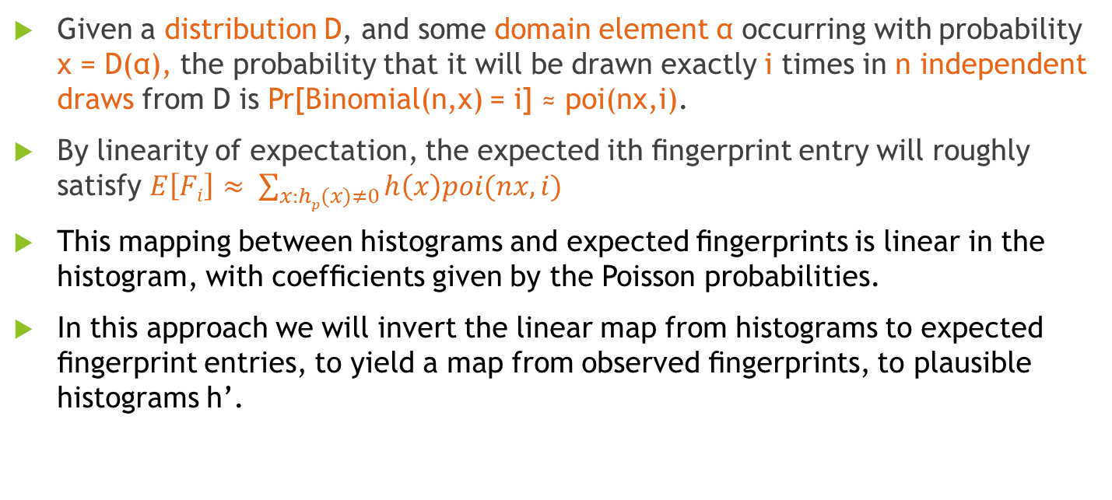
Proposed approach
Given a distribution D, and some domain element α occurring with probability x = D(α), the probability that it will be drawn exactly i times in n independent draws from D is Pr[Binomial(n,x) = i] ≈ poi(nx,i).
By linearity of expectation, the expected ith ﬁngerprint entry will roughly satisfy $E\left[Fi\right]≈ \sum_{x:hp(x)≠0}{h\left(x\right)poi(nx,i)}$
This mapping between histograms and expected ﬁngerprints is linear in the histogram, with coefﬁcients given by the Poisson probabilities.
In this approach we will invert the linear map from histograms to expected ﬁngerprint entries, to yield a map from observed ﬁngerprints, to plausible histograms h’.

Slide 8
Proposed approach(Contd.)
For many ﬁngerprints, there will be a large space of equally plausible histograms.
Instead of our initial goal of returning a histogram that could have plausibly generated the observed ﬁngerprint, we instead return the simplest histogram that could have plausibly generated the observed ﬁngerprint.

Slide 9
Thank You

